Slide 1
Cultural Competence and Language Seeing the Whole Elephant
David Irwin
Language Development Opportunities
dave@langdevopps.com

Slide 2
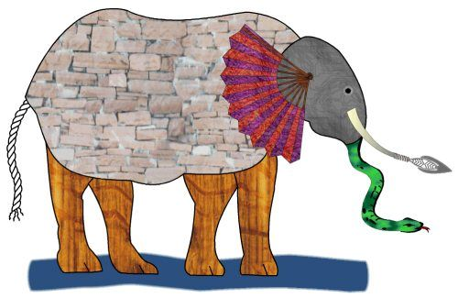
A little story… The Blind Men and the Elephant

Slide 3
Outcomes
Participants will have the opportunity to
Explore their own cultural history and discover how it affects their approach to education
Engage in dialogue with colleagues about the relationship between culture and language
Examine their professional practice as to how it aligns to the learning needs of culturally and linguistically diverse students

Slide 4
The Numbers… in Tukwila

Slide 5
Student Demographics
Enrollment: 2,900 + Students
Gender: 51.8% Male/ 48.2% Female
Race/Ethnicity:
American Indian/Native 0.7%
Asian/Pacific Islander 28.3%
Black/African American 19.5%
Hispanic 26.4%
White 15.4%
Mixed/Multi Race 6.1%
Poverty/F &R: 77.6%
Sped: 9.2%
Tran. Bilingual: 38.6%
Washington State Report Card 2012-2013
Notes:
Here is the TSD Student Demographics taken from the WA State Report Card 2012-2013. Review enrollment (over 3 thousand students), gender, race/ethnicity (over 60%ethnic enrollment), poverty rate (over 50%). FWPS like most districts are experiencing huge demographic shifts as many districts statewide and nationally. I’d like for you to hold on to the demographic information as I review the next few data slides .

Slide 6
Number of Elementary Suspensions

Slide 7
Number of Elementary Suspensions by Gender

Slide 8
Number of Elementary Suspensions by Race

Slide 21
So…
Are there ways the students’ home culture interacts with the school culture that makes them more… or less… successful?
What is culture anyway, and what does it have to do with school?
Aren’t we really here to teach reading, math, science, etc? Do I have to think about culture to do that?

Slide 22
What Is Culture?
Concrete Level -- Heroes and Holidays, dances, costumes, food, flags.
Behavioral Level – Language, religious practices, gender roles, rituals.
Symbolic Level – Shared values, beliefs, mores, definition of family, meaning of education.
Nitza Hidalgo: Multicultural Teacher Introspection
Notes:
Purpose: Show Ps that their own culture affects their world view and even their teaching style
Procedures: Awareness Activity: Participants sit in a circle for this exercise if possible. Facilitator hand out a list of questions for each participant to answer for the group. Possible questions could include name/nicknames, ethnic background, where they are from and where their parents were born, which generation they represent in America for their family, and one custom or tradition their family practices. Give participants time to write down some ideas for answering the questions.
Before you begin the exercise, instruct the participants to identify one or two people in the group whom they do not know, and to think about what answers they expect from those people. This part is not to be shared among group members, but can help people realize how they formulate ideas about people based on appearance.
Now you are ready to begin. It is important to tell the group that each person will be limited to about two minutes in order for everyone's voice to be heard. Once everyone has had an opportunity to share their information, ask the group to discuss what they have learned from the exercise. There are many definitions for culture. Some think of big “C” “Culture” which would refer to the opera, art museums, etc. But culture affects every aspect of life.
Culture can be compared to an iceberg. Only one seventh of the iceberg can be seen. “Above-the-surface” cultural aspects are heroes, holidays, food, music, clothing. These are obvious to those from another culture.
However, below the service, the other six sevenths of the iceberg, is where the potential danger lies. It’s the aspects of culture you don’t know about that usually breeds misunderstandings. These underlying cultural rules have to do with eye contact, gender roles, child-rearing issues, attitudes about youth and the aged, personal space, facial expressions and body language to name a few. Here are a few examples:
In many Asian cultures it is an insult to pat a child on the head.
Many youth, particularly Hispanic, are taught not to look an adult eye-to-eye; that is a sign of challenge or disrespect.
In many cultures it is poor manners (or even insulting) to introduce yourself to someone, especially across genders. You must be introduced by a third party.
In many cultures showing the bottom of your feet (as in crossing your legs and picking up your foot from the ground) is a terrible offense.
The American “ok” hand gesture is obscene in most of the rest of the world.
Materials:
Minutes: 15

Slide 23
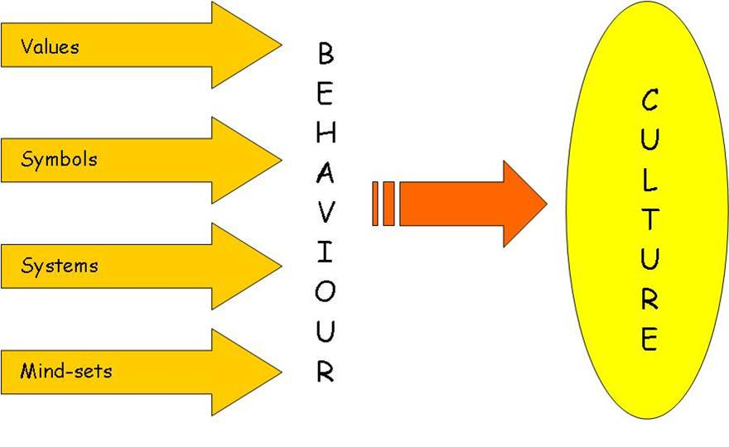
What is Culture?
http://www.haydonpi.com.au/pages/positive-workplace-culture.php

Slide 24
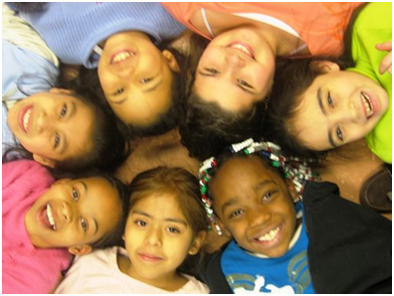
What Is Culture?
Culture is “a group’s program for survival in and adaptation to its environment. The cultural program consists of knowledge, concepts, and values shared by group members through systems of communication.”
Discuss how each of the highlighted ideas helps define culture.
Bullivant (1993)
Notes:
Purpose: Show Ps that their own culture affects their world view and even their teaching style
Procedures: Awareness Activity: Participants sit in a circle for this exercise if possible. Facilitator hand out a list of questions for each participant to answer for the group. Possible questions could include name/nicknames, ethnic background, where they are from and where their parents were born, which generation they represent in America for their family, and one custom or tradition their family practices. Give participants time to write down some ideas for answering the questions.
Before you begin the exercise, instruct the participants to identify one or two people in the group whom they do not know, and to think about what answers they expect from those people. This part is not to be shared among group members, but can help people realize how they formulate ideas about people based on appearance.
Now you are ready to begin. It is important to tell the group that each person will be limited to about two minutes in order for everyone's voice to be heard. Once everyone has had an opportunity to share their information, ask the group to discuss what they have learned from the exercise. There are many definitions for culture. Some think of big “C” “Culture” which would refer to the opera, art museums, etc. But culture affects every aspect of life.
Culture can be compared to an iceberg. Only one seventh of the iceberg can be seen. “Above-the-surface” cultural aspects are heroes, holidays, food, music, clothing. These are obvious to those from another culture.
However, below the service, the other six sevenths of the iceberg, is where the potential danger lies. It’s the aspects of culture you don’t know about that usually breeds misunderstandings. These underlying cultural rules have to do with eye contact, gender roles, child-rearing issues, attitudes about youth and the aged, personal space, facial expressions and body language to name a few. Here are a few examples:
In many Asian cultures it is an insult to pat a child on the head.
Many youth, particularly Hispanic, are taught not to look an adult eye-to-eye; that is a sign of challenge or disrespect.
In many cultures it is poor manners (or even insulting) to introduce yourself to someone, especially across genders. You must be introduced by a third party.
In many cultures showing the bottom of your feet (as in crossing your legs and picking up your foot from the ground) is a terrible offense.
The American “ok” hand gesture is obscene in most of the rest of the world.
Materials:
Minutes: 15

Slide 25
What Is Culture in the USA?
We are a multicultural society.
We share a core culture as well as many subcultures.
Discuss: Tying to the ideas in the last slides, what is your understanding (experience, opinion) of U.S. core culture?
Notes:
Purpose: Show Ps that their own culture affects their world view and even their teaching style
Procedures: Awareness Activity: Participants sit in a circle for this exercise if possible. Facilitator hand out a list of questions for each participant to answer for the group. Possible questions could include name/nicknames, ethnic background, where they are from and where their parents were born, which generation they represent in America for their family, and one custom or tradition their family practices. Give participants time to write down some ideas for answering the questions.
Before you begin the exercise, instruct the participants to identify one or two people in the group whom they do not know, and to think about what answers they expect from those people. This part is not to be shared among group members, but can help people realize how they formulate ideas about people based on appearance.
Now you are ready to begin. It is important to tell the group that each person will be limited to about two minutes in order for everyone's voice to be heard. Once everyone has had an opportunity to share their information, ask the group to discuss what they have learned from the exercise. There are many definitions for culture. Some think of big “C” “Culture” which would refer to the opera, art museums, etc. But culture affects every aspect of life.
Culture can be compared to an iceberg. Only one seventh of the iceberg can be seen. “Above-the-surface” cultural aspects are heroes, holidays, food, music, clothing. These are obvious to those from another culture.
However, below the service, the other six sevenths of the iceberg, is where the potential danger lies. It’s the aspects of culture you don’t know about that usually breeds misunderstandings. These underlying cultural rules have to do with eye contact, gender roles, child-rearing issues, attitudes about youth and the aged, personal space, facial expressions and body language to name a few. Here are a few examples:
In many Asian cultures it is an insult to pat a child on the head.
Many youth, particularly Hispanic, are taught not to look an adult eye-to-eye; that is a sign of challenge or disrespect.
In many cultures it is poor manners (or even insulting) to introduce yourself to someone, especially across genders. You must be introduced by a third party.
In many cultures showing the bottom of your feet (as in crossing your legs and picking up your foot from the ground) is a terrible offense.
The American “ok” hand gesture is obscene in most of the rest of the world.
Materials:
Minutes: 15

Slide 26
What is U.S. Core Culture?
Did you mention…
Equality
Individualism
Expansionism (Manifest Destiny)
Consumerism
Other?
These are traditional dominant culture American ideals. How do they enhance or conflict with everyday reality, and especially that of your students?
Are these ideals always available or even desirable for every person based on their cultural membership?

Slide 27
Social Categories of Culture
What are they and why are they called “social”? Brainstorm with your table…
National origin
Gender
Religion
Ethnicity
Exceptionality
Sexual orientation
Economic level
Age
Race
More?

Slide 28
How about culture in school?

Slide 29
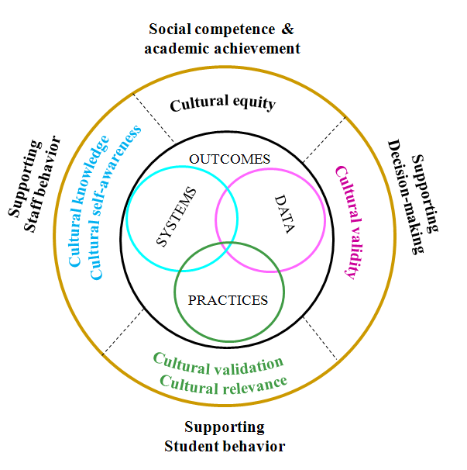
From Response to Intervention RTI; Wanda Billingsley
Notes:
The RtI intervention model works best when implemented with a cultural competency overlay-There is a wealth of research that examines the connection between culture and learning (Tyrone Howards- new book entitle Race Matters, Dr. Leona Johnson’s book entitled What we know about culture and learning).
29

Slide 30
Theoretical Foundation for the Use of Primary Language for ELD
Collier and Thomas’ Prism Model
Social and cultural processes are at the heart of successful programs for English learners.
Notes:
Directions to Facilitator
Oral language development, especially in the academic domain, is important in both an ELLs’ first language as well as English. Use of the home language for instruction has advantages because the student can work on academic concepts more easily, without the effort and stress of simultaneously translating.
Thomas & Collier first developed the Prism Model in 1994 to show the interrelationship between aspects of first and second language development and social and cultural influences. Their work suggests the education of an English learners cannot be separated from the student’s home culture and home language. Later research by them and others show that the learning of English is actually accelerated by the use and support of the home language and culture.
Pause for discussion here/
Background Information for the Facilitator
See National Clearinghouse for Bilingual Education
Vol. 1, No. 4, Fall 1995
ACQUIRING A SECOND LANGUAGE FOR SCHOOL
by Virginia P. Collier, George Mason University

Slide 31
Are there mismatches between a student’s home culture and the school culture?
Who defines and sets the rules in the school culture?
Who teaches the rules to the students?
Are the teaching methods for teaching the cultural rules culturally appropriate?
Group membership and individual difference…
Differentiation and scaffolding…

Slide 32
Language and Culture
Language is a marker of membership
Language influences patterns of thought
Our students come with
Varieties of non-standard English
Pidgins
Creoles
Dialects
Languages other than English
Varieties of those languages

Slide 33
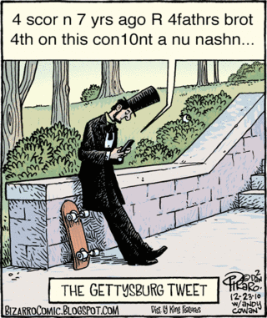
Notes:
Purpose: humor, connected to casual and academic registers
Procedures:
Materials:
Minutes:

Slide 34
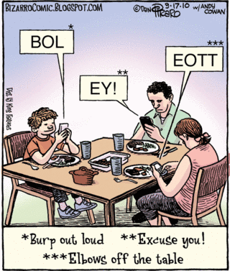

Slide 35
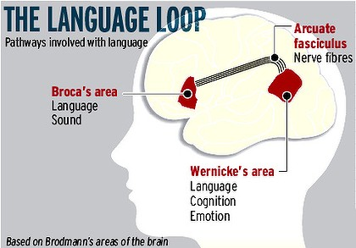
Language Distance from English
Language influences
thinking
In the next slides, what could be instructional and cultural implications for someone from these language backgrounds as he/she attempts to operate in a Mainstream/English speaking environment?

Slide 36
Linguistic Distance: Spanish
Different than English
Inflected
two-gender noun system
Fifty+ conjugated forms per verb
usually places adjectives after nouns
allows the deletion of unnecessary pronouns
Similar to English
uses prepositions
syntax is generally subject–verb–object

Slide 37
Linguistic Distance: Vietnamese
Vietnamese:
does not use morphological marking of case, gender, number or tense – tonal instead
syntax conforms to subject–verb–object word order
noun classifier system.
Some Vietnamese sentences with English word glosses and translations are provided below.
Mai là sinh viên.
Mai be student
"Mai is a student." (College student)
Giáp rất cao.
Giap very tall
"Giap is very tall.“
Người đó là anh nó.
person that be brother he
"That person is his brother."

Slide 38
Linguistic Distance: Somali
agglutinative language, using a number of tonal markers for case, gender and number
multiple forms of most personal pronouns to show position, status, etc.
gender polarity (the gender of many words is different in the singular and plural forms).

Slide 39
Discourse Patterns Tied to Culture
Linear
Ideas are developed in a sequential pattern, leading to conclusion. 5 paragraph essay.
Circular
Ideas are developed by creating context to illustrate conclusion – will “get around” to the main point eventually
Notes:
Purpose: Show that people communicate in different ways, dep-ending on many factors – age, gender, culture, economic status, etc.
Procedures: lecture
Materials: none
Minutes: 3

Slide 40
Discourse Patterns
Direct
Statements are made directly, little reliance on context or timing.
Indirect
Meaning conveyed by suggestion, nonverbal cues, or statements made within earshot of the intended receiver but not directly to them.
Notes:
Purpose: see 148
Procedures:
Materials:
Minutes:

Slide 41
Discourse Patterns
Detached
Discussion is calm and objective. Focus on the ideas, not the person.
Attached
Discussion is passionate, emotional. Speaker conveys his/her personal connection to the issue.
Notes:
Purpose: see 148
Procedures:
Materials:
Minutes:

Slide 42
Translate Direct to Indirect:
That’s not a good idea.
You’re doing that wrong. Let me help you.
I disagree.
The instructions are...
My expectations are…
What we need to do is…
What do you think, Anh?
Notes:
Purpose: Ps experience examples of differing communication styles by translating meaning
Procedures: partners confer to translate
Materials: packet
Minutes: 5

Slide 43
Translate Indirect to Direct
That’s a very interesting idea.
Thank you for your input.
I see what you’re saying.
We will try our best.
I’ll really try to make it to the party.
Notes:
Purpose: see 151
Procedures:
Materials:
Minutes:

Slide 44
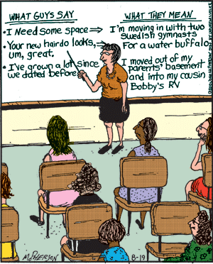
Notes:
Purpose: Add humor to the concept opf translating styles
Procedures: allow silence while Ps read
Materials: none
Minutes: 2

Slide 45
Registers of Oral Language
Register | Description
Frozen | Language that is always the same. The Pledge of Allegiance, Lord’s Prayer, etc.
Formal | Language that is prepared in advance, in one-way, is not designed for response. Speaker provides background information.
Consultative/Academic | Language designed for interaction between people who may not know each other well. Speaker provides background information, minimal use of slang or jargon, use of standard grammar understood by all (or most) speakers of English.
Casual | Language between friends. Assumes participants have the same background information. May include slang and ellipsis (omission of certain commonly understood words).
Casual Vulgar Montaño-Harmon | Simliar to above with use of profanity as common vocabulary among certain groups.
Intimate | Language between close friends & family. Assumes large amount of background knowledge. One word may carry much meaning. Much use of ellipsis and/or slang or “pet” words.
From The Five Clocks, Martin Joos, Harcourt Brace, 1967. Adapted in Montano-Harmon (03) & Payne (05).
Notes:
Purpose: Show that students (and people) have different ways of using language depending on setting. We need to allow & honor students’ native language & register while teaching them and ensuring that they practice academic or consultative regiater.
Procedures: lecture/discussion
Materials: packet
Minutes: 5

Slide 46
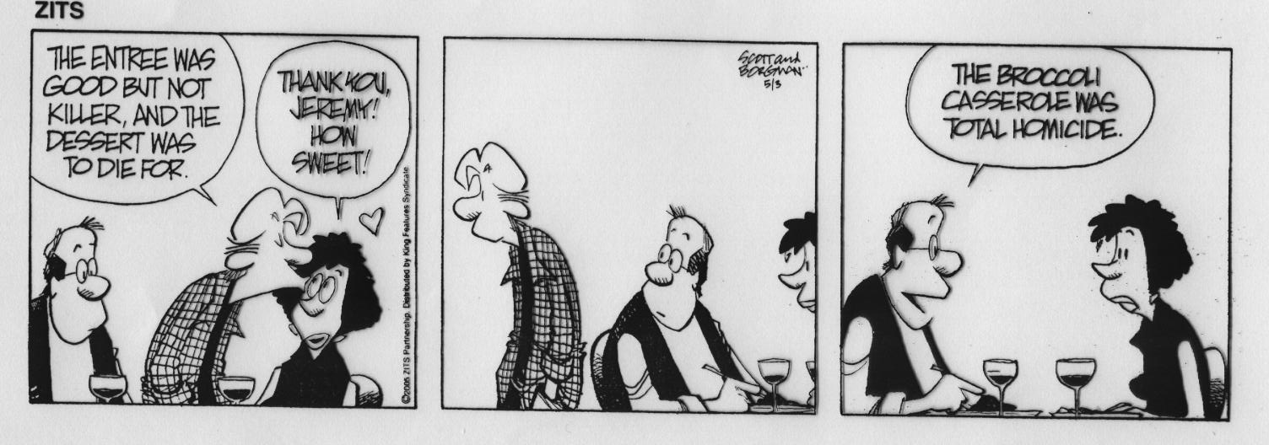
Notes:
Purpose: humor
Procedures:
Materials:
Minutes:

Slide 47
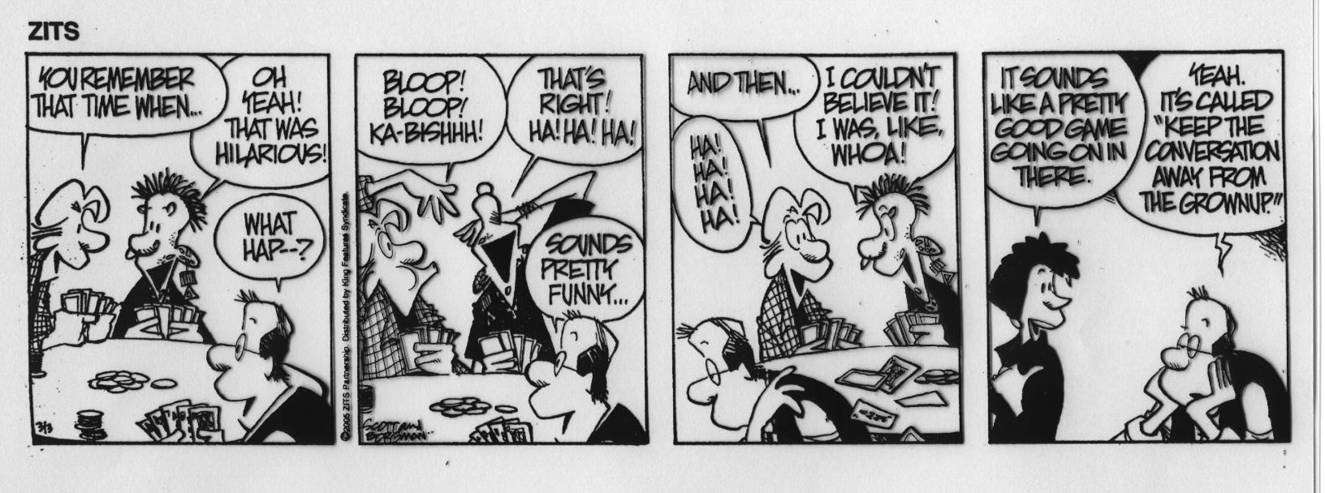
Notes:
Purpose: humor
Procedures:
Materials:
Minutes:

Slide 48
Multicultural Awareness Try this:
We start with ourselves. Consider categories of culture, discourse patterns, registers, personal sociocultural history. In a group of 3 or 4:
If you choose to, please share about these topics:
where you are from and where your parents were born
which generation you represent in the US for your family
your ethnic background, gender and disability (if you have one)
whether you ever felt singled out because of any of them
if your first language was not English, how was it for you to learn it in social and academic settings
one Concrete custom or tradition your family practices
one Behavioral custom or tradition you family practices
tell whether your family communicates in a more direct or indirect way
some of the linguistic markers (slang) of your own teen culture
How did you say “That’s really great” around your friends when you were 15?
What else were common words or patterns of speech for you back then?
How about now?
Before beginning, make some private predictions about what you think your colleagues will say
Consider how your students might answer these
Notes:
Purpose: see 146
Procedures: see 146
Materials:
Minutes:

Slide 49
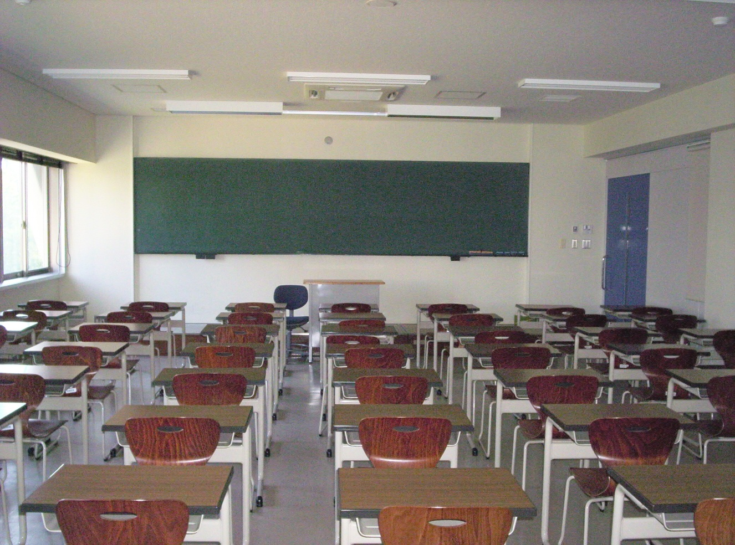
What does a culturally responsive school NOT look/sound like?

Slide 50
Teacher Talk
Teachers make about twice as many utterances as do students. (I’ve heard as much as 9:1)
In over half the interactions that teachers have with students, students do not produce any language.
When students do respond, they typically provide only simple one or two word information recall statements (word-burps).
(Goldenberg, 1992-1993)
(Making Content Comprehensible, 2004, p. 103)
Notes:
Purpose: see 163
Procedures: Implications – other shoulder partner
Materials: none
Minutes:

Slide 51
Characteristics of Instruction Provided to Low-Achieving Groups:
Teachers talk more
Teachers use more structure
Teachers ask lower-level questions
Teachers cover less material
Teachers spend more time on skills and drills
Teachers provide fewer opportunities for leadership and independent research
Teachers encourage more oral than silent reading
Teachers teach less vocabulary
Teachers allow less wait time during questions
Teachers spend twice as much time on behavior and management issues
Take 3 minutes and discuss these characteristics. Do you agree/ disagree? Why or why not?
(Making Content Comprehensible, 2008, p. 126)
Notes:
Purpose: Show that teachers talk far more than students and that it is linked with low achievement
Procedures: Read & respond. Shoulder partners, then 2 BIG points to another pair.
Materials: none
Minutes: 5

Slide 52
Speech Pacing
How fast do you talk? ELLs and other students need a slower pace of speech.
Challenge: tape or video yourself while teaching or talking to a group.
Tip: Listen to yourself while teaching as if you’re one of the students.
Notes:
Purpose: Discuss speech pacing relative to students’ needs to hear speech at a relatively slow pace
Procedures: lecture
Materials: none
Minutes:

Slide 53
Mainstream instructional practices
Traditional, even currently researched, literacy instructional practices may not match the cultural literacy practices of a population.
Those who are socially, economically, or politically more powerful tend to determine the kind of literacy practices that are valued, and texts used to teach them.
The Common Core State Standards are much improved but still just one version.
Source: Hull, G. A. & Moje, E. B. (2012) What’s the Development of Literacy the Development Of?

Slide 54
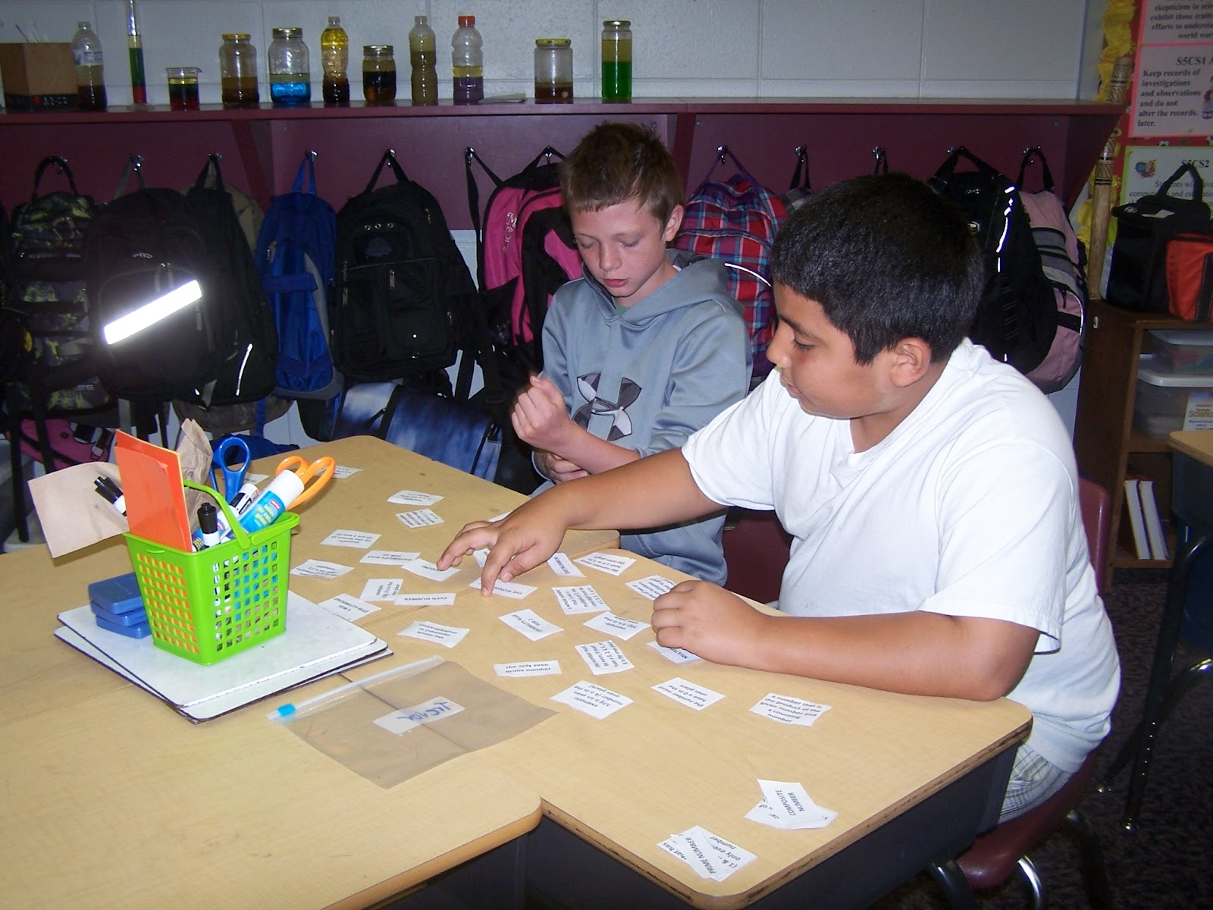
What DOES a culturally responsive school look/sound like?

Slide 55
Two Models
Wlodowski & Ginsberg (1995) Diversity & Motivation: Culturally Responsive Teaching
Hull, G. A. & Moje, E. B. (2012) What’s the Development of Literacy the Development Of?

Slide 56
Culturally Responsive Framework
Establishing inclusion
Developing attitude
Enhancing meaning
Engendering competence
Wlodowski & Ginsberg (1995)
Diversity & Motivation: Culturally Responsive Teaching
Wlodowski & Ginsberg (1995) Diversity & Motivation: Culturally Responsive Teaching.
From a presentation by Dr. Letitia Fickel, Univ of Canterbury, New Zealand, 2004

Slide 57
Establishing Inclusion
The norms, procedures and structures that are woven together to form a learning context in which all learners and the teacher feel respected by and connected to one another.
Wlodowski & Ginsberg (1995) Diversity & Motivation: Culturally Responsive Teaching.
From a presentation by Dr. Letitia Fickel, Univ of Canterbury, New Zealand, 2004

Slide 58
Establishing Inclusion
Collaborate to create the norms
If norms are different from what students are used to at home, they are able to understand and negotiate them
Model behavior
Elicit information about clarity through on-going feedback
Establish ground rules with students for the discussion of controversial or sensitive topics
use dialogue structures
Wlodowski & Ginsberg (1995) Diversity & Motivation: Culturally Responsive Teaching.
From a presentation by Dr. Letitia Fickel, Univ of Canterbury, New Zealand, 2004

Slide 59
Developing Attitude
Norms, procedures and structures that create through relevance and choice a favorable disposition among learners and teachers toward the learning experience and learning goals.
Wlodowski & Ginsberg (1995) Diversity & Motivation: Culturally Responsive Teaching.
From a presentation by Dr. Letitia Fickel, Univ of Canterbury, New Zealand, 2004

Slide 60
Developing Attitude
Develop creative and effective ways to learn about your student’s lives and interests.
Conduct interest inventories both general and content specific.
Use “getting to know you” activities.
Organize regularly scheduled discussion topics (including current events) that allow students to connect course material to the “real world”
Design course in ways that encourages learners to make choices about class topics and assignments.
Wlodowski & Ginsberg (1995) Diversity & Motivation: Culturally Responsive Teaching.
From a presentation by Dr. Letitia Fickel, Univ of Canterbury, New Zealand, 2004

Slide 61
Enhancing Meaning
Norms, procedures and structures that expand, refine, or increase the complexity of what is learned in ways that matter to learners, includes their values and purposes, and contributes to a critical consciousness.
Wlodowski & Ginsberg (1995) Diversity & Motivation: Culturally Responsive Teaching.
From a presentation by Dr. Letitia Fickel, Univ of Canterbury, New Zealand, 2004

Slide 62
Enhancing Meaning
Examine the embedded values in your discipline that may confuse or disturb students, or may be challenging to their own cultural perspectives.
Have students identify their prior knowledge and understandings of key concepts, issues, or content or how it is understood in their culture/community.
Include readings/authors that reflect the diversity of thought and people within your discipline.
Encourage students to represent alterative perspectives or construct panels that can discuss issues from diverse perspectives.
Use language that reflects the disciplinary way of “knowing” or “understanding” as one way, not the only or “right way.”
Explicitly address the embedded values in the discipline.
Wlodowski & Ginsberg (1995) Diversity & Motivation: Culturally Responsive Teaching.
From a presentation by Dr. Letitia Fickel, Univ of Canterbury, New Zealand, 2004

Slide 63
Enhancing Meaning
Critically examine the examples you use to illustrate key points to ensure they are meaningful and sensitive to your students.
Use analogies or metaphors from everyday life to help illustrate abstract concepts.
Have students suggest other examples, analogies or metaphors, or ones that illustrate other key points.
Systematically collect examples, metaphors, and analogies from students to use in the future--and give credit!
Use graphic organizers, and context-rich visuals or materials
Wlodowski & Ginsberg (1995) Diversity & Motivation: Culturally Responsive Teaching.
From a presentation by Dr. Letitia Fickel, Univ of Canterbury, New Zealand, 2004

Slide 64
Engendering Competence
The norms, procedures and structures that create an understanding for learners of how they are or can be effective in learning something of personal value.
Wlodowski & Ginsberg (1995) Diversity & Motivation: Culturally Responsive Teaching.
From a presentation by Dr. Letitia Fickel, Univ of Canterbury, New Zealand, 2004

Slide 65
Engendering Competence
Support student in goal setting for projects.
Create some learning activities and assessments that are suited to different multiple intelligences.
Provide clear and explicit criteria for assignments/assessments.
Use multiple forms of assessment that reflect the modes of teaching and learning you have employed.
Wlodowski & Ginsberg (1995) Diversity & Motivation: Culturally Responsive Teaching.
From a presentation by Dr. Letitia Fickel, Univ of Canterbury, New Zealand, 2004

Slide 66
Engendering Competence
Provide models of “high quality” work and discuss them with students.
Adopt a “cognitive coaching” stance to teaching; model and highlight in course readings & discussions the thinking, ways of making arguments, and use of academic rhetoric.
Provide frequent feedback that is based on agreed-upon standards, specific and constructive, and personally informative to student development and growing competence.
Wlodowski & Ginsberg (1995) Diversity & Motivation: Culturally Responsive Teaching.
From a presentation by Dr. Letitia Fickel, Univ of Canterbury, New Zealand, 2004

Slide 67
Engendering Competence
Use the “writing process” format so that students get on-going feedback from you and form peers as they develop their work.
Use self-assessment to engender student understanding of their attainment and on-going development toward competence.
Use reading & anticipation guides to support critical engagement with text.
Increase the amount of time that students are talking about the concepts and ideas--collaborative and cooperative group work.
Wlodowski & Ginsberg (1995) Diversity & Motivation: Culturally Responsive Teaching.
From a presentation by Dr. Letitia Fickel, Univ of Canterbury, New Zealand, 2004

Slide 68
Key Findings
Literacy learning is situated in and mediated by social and cultural interactions and tools. Learning is shaped by
the cultural practices of the group (class)
the social interactions of the group (class)
the activities and activity systems in which literacy lessons occur;
How do you organize and allow social interactions and connect them to content?
Hull, G. A. & Moje, E. B. (2012) What’s the Development of Literacy the Development Of?
Available at http://ell.stanford.edu/publication/what-development-literacy-development
Notes:
1.: Elaborate: Learning is shaped by the cultural practices of the group (class) which are often taken for granted, the social interactions of the group (class), and .
2.:

Slide 69
Key Findings
Literacy learning occurs via a range of explicit and implicit teaching, usually guided by interaction with a more knowledgeable “other” over time. Basic tenets of sociocultural theory includes
Communities of practice/learners
responsive teaching (marked by teacher listening to student discourse and assessing existing knowledge in order to scaffold the development of new knowledge;
How do you organize opportunities for students to use academic discourse (not just word-burping)?
Hull, G. A. & Moje, E. B. (2012) What’s the Development of Literacy the Development Of?
Available at http://ell.stanford.edu/publication/what-development-literacy-development

Slide 70
Key Findings
Across the age range and from all socio/cultural groups, people learn and practice literacy outside of school.
What are your methods for tapping students background experiences and connecting them to content?
Hull, G. A. & Moje, E. B. (2012) What’s the Development of Literacy the Development Of?
Available at http://ell.stanford.edu/publication/what-development-literacy-development

Slide 71
Key Findings
To learn literacy, students need meaningful purposes for engaging in literate practice and opportunities to use literacy for a broad range of life.
Gaming: some high informational literacy demands and provide motivational context for participation.
Literacy instruction doesn’t always have to be based on popular cultural activities (fun), but a sense of the purposefulness of literacy is key for learning.
Do you connect lessons (or parts of lessons) to a purpose that makes sense to the student?
Hull, G. A. & Moje, E. B. (2012) What’s the Development of Literacy the Development Of?
Available at http://ell.stanford.edu/publication/what-development-literacy-development

Slide 72
Key Findings
Learners require, and literate ability now consists of, facility with composing, interpreting, and transforming information and knowledge across various forms of representation.
Numeric symbols, icons, static images, moving images, oral representations, graphs, charts, and tables, powerpoint, Publisher.
Impact of the information revolution on the transformation of literacy practices is huge.
Do your students have multiple avenues for expressing ideas – visual, musical, written, oral, etc?
Hull, G. A. & Moje, E. B. (2012) What’s the Development of Literacy the Development Of?
Available at http://ell.stanford.edu/publication/what-development-literacy-development

Slide 73
Teaching Literacy to a Multicultural Student Population
Traditionally:
Cognitive processes
Individual responsibility
With a multicultural perspective:
Context
Learning environment more closely matches student’s culture -- grouping, timing, etc.
Social interaction

Slide 74
Best New Practices for Multi-sociocultural meaning making in school
Academic or Constructive Conversations
Use of academic discourse in personal conversations about content
Students bring their own perspective and truth to academic challenges
Hakuta & Zwiers
Whole Brain Teaching
Specific interactive verbal and physical strategies to start and manage conversations
Uses whole body (whole brain) approach to engagement
Chris Biffle
Teacher/Principal Evaluation Project (TPEP) Criterion 3 and 7
Promotes using students’ backgrounds and families as factors in planning high quality lessons

Slide 76
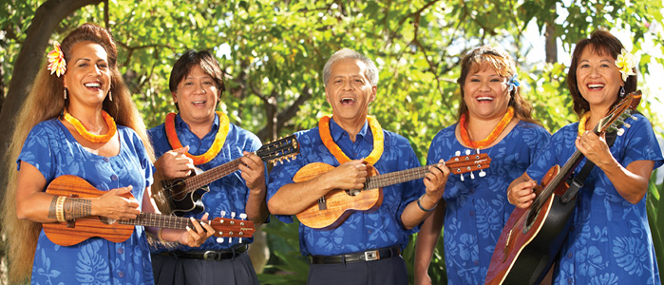
Back to Your Practice….
Look back over the information in this presentation, and some of your own responses.
What new ideas can you take back to your students or coworkers that will enhance learning for culturally and linguistically diverse students?
…and it’s OK to move slowly… with intention. One new idea can change the world!
Thank you for
your time today!

Slide 77
Resources
Banks, J. A. & Banks, C. A. M., eds. (2005) Multicultural Education: Issues and Perspectives. Hoboken, NJ: Wiley & Sons.
Biffle, C. (2013) Whole Brain Teaching. Website: http://wholebrainteaching.com
Bullivant, B. (1993) Culture: Its Nature and Meaning for Educators. In Banks, J. A. & Banks, C. A. M., eds. (2005) Multicultural Education: Issues and Perspectives. Hoboken, NJ: Wiley & Sons.
Diller, J.V. & Moule, J. (2005) Cultural Competence: A Primer for Educators. Belmont, CA: Thomson Wadsworth.
Fadiman, A. (1997) The Spirit Catches You and You Fall Down: A Hmong Child, Her American Doctors, and the Collision of Two Cultures. New York, NY: Farrar, Strauss, and Giroux.
Hidalgo, N. M. (1993) Multicultural Teacher Introspection in Perry, T. & Fraser, J.W. (1993) Freedom’s Plow: Teaching in the Multicultural Classroom. New York, NY: Routledge.
Hull, G. A. & Moje, E. B. (2012) What’s the Development of Literacy the Development Of? Downloaded 10/17/2013 from http://ell.stanford.edu/papers/language
Wlodowski, R.J. & Ginsberg, M.B (1995) Diversity & Motivation: Culturally Responsive Teaching. San Francisco: Jossey-Bass.
Jensen, E. (2009) Teaching with Poverty in Mind: What Being Poor Does to Kids’ Brains and What Schools Can Do About It. Alexandria, VA: ASCD.
Lindsay, R., Karns, M., Myatt, K. (2010) Culturally Proficient Education: An Asset-Based Response to Conditions of Poverty. Corwin Press.
Ovando, C. J., Language Diversity and Education in Banks, J. A. & McGee Banks, C. A., (2001) Multicultural Education: Issues & Perspectives. New York: Wiley & Sons.
Notes:
Purpose:
Procedures:
Materials:

